Slide 1

Creational Design Patterns

Slide 2
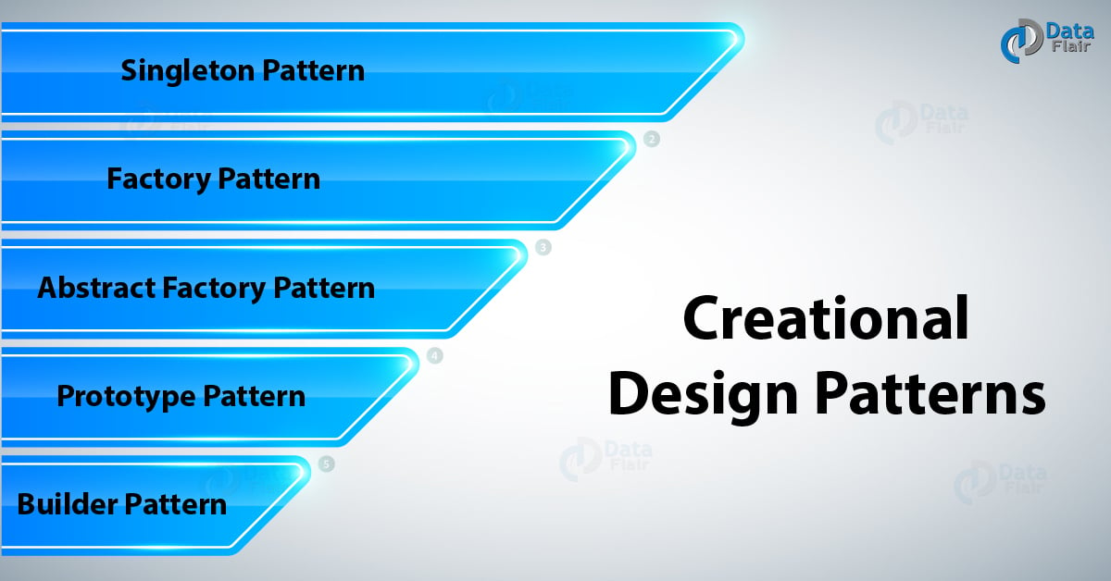
Creational Design Pattern
How object must be created
Singleton
Factory
Abstract Factory
Builder
Prototype

Slide 3
Singleton
It is about creating only one object of your class
Steps to use Singleton Design Pattern:-
Declare constructor of the class a private
Declare private and static reference of class in same class.
A class must provide a global access point to get object of that class.

Slide 4
Implementing Singleton
public class Logger {
private static Logger instance;
private Logger() {
public static Logger getInstance() {
if (instance == null) {
instance = new Logger();
}
return instance;
public void log(String message) {
System.out.println(message);
public class TestLogger {
public static void main(String[] args) {
Logger logger1=Logger.getInstance();
Logger logger2=Logger.getInstance();
logger1.log("Here i am logged");
logger2.log("Here again i am logging");

Slide 5
Factory
it allows the subclass to choose the objects to create
Steps to use Singleton Design Pattern:-
1. Create factory class
2. Create method to create object of subclass independant of superlcass

Slide 6
Implementing Factory
public abstract class Pizzas {
public abstract void prepare();}
public class PizzaFactory {
private static Pizzas pizzas;
public static Pizzas getPizzas(String pizzaname) {
if(pizzaname.contentEquals("onion")) {
pizzas=new onion();
}
if(pizzaname.contentEquals("MargheritaPizza")) {
pizzas=new MargheritaPizza();
}
return pizzas;
}
}

Slide 7
public class MargheritaPizza extends Pizzas {
public void prepare() {
System.out.println("MargheritaPizza pizza");
}
}
package com.techlabs.creationalppt.factory;
public class onion extends Pizzas {
public void prepare() {
System.out.println("Onion pizza");
public class TestPizzas {
public static void main(String[] args) {
Pizzas Onion=PizzaFactory.getPizzas("onion");
Onion.prepare();
Pizzas margheritaPizzas=PizzaFactory.getPizzas("MargheritaPizza");
margheritaPizzas.prepare();
}
}

Slide 8
Abstract Factory
pattern provides one of the best ways to create an object
Abstract Factory patterns work around a super-factory which creates other factories. This factory is also called as factory of factories.
Abstract Factory pattern an interface is responsible for creating a factory of related objects without explicitly specifying their classes.
Each generated factory can give the objects as per the Factory pattern.

Slide 9

Builder Pattern
The Builder pattern separates the construction of a complex object from its representation, allowing the same construction process to create different representations.
It provides a step-by-step approach to building an object, where each step is handled by a separate builder object.
This pattern is useful when there are multiple ways to construct an object, or when the object construction involves many steps.

Slide 10

Prototype Pattern
The Prototype pattern allows you to create new objects by cloning existing ones, without relying on subclassing.
It provides a way to create new objects based on a prototype object, which is an instance of the same class.
This pattern is useful when creating new objects is costly or complex, and when the new objects are similar to existing ones with only minor differences.

Slide 11

Thank you

